Slide 1
Molecular Simulation
This module will consist of a
mini-lecture on molecular simulation including Markov Chain Monte Carlo, Molecular Dynamics and Hybrid Monte Carlo
walk-through of a python script to run HMC with Robosample
At the end of this module, you should be able to address these questions:
What is Markov Chain Monte Carlo and Molecular Dynamics?
What is Hybrid Monte Carlo and why do people use it?
Generally speaking, how does a Hybrid Monte Carlo simulation work?
You should also be able to run a simulation of a simple system using Robosample

Slide 2
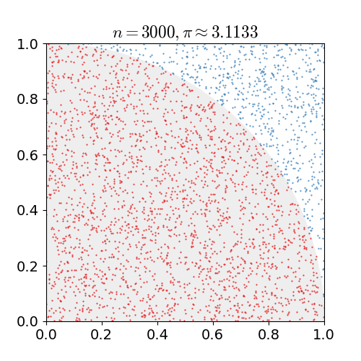
Monte Carlo
Monte Carlo simulation:
named after famous gambling city
uses random numbers
usually applied to hard deterministic or probabilistic problems
Examples:
pi approximation
virtually tossing a coin or rolling a dice many times
estimating financial risk (uncertainty in unit price, sales…)
solving integrals / differential equations
Cannot use it for complex highly dimensional probability distribution
Notes:
https://en.wikipedia.org/wiki/Monte_Carlo_method: Kalos, Malvin H.; Whitlock, Paula A. (2008). Monte Carlo Methods. Wiley-VCH. ISBN 978-3-527-40760-6.

Slide 3

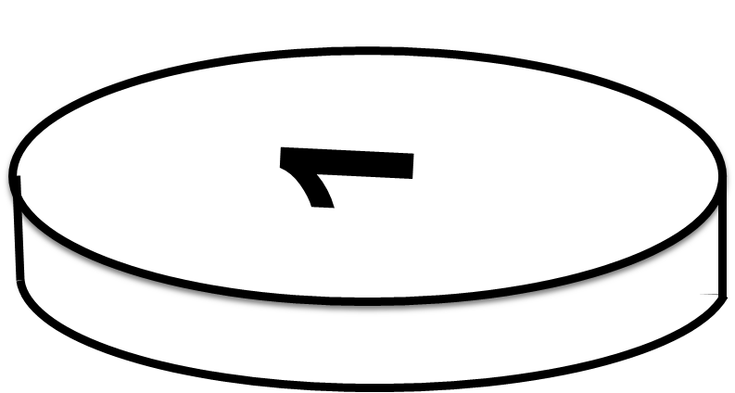
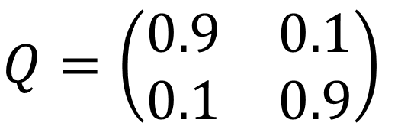
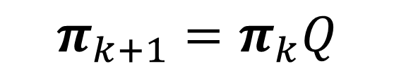
Markov Chains
Stochastic process: Sequence of random variables mapped to another variable (t)
Markovian property: memoryless: future only depends on the present
Chain diagrams and transition matrix
$X$ = stochastic proccess; $χ$ = state space; $π$ = probability vector;
$$π=\left[π\left(A\right),π\left(B\right)\right], π(A)=P(X_{ }=A)$$
$$X=\left\{X_{0},X_{1},X_{2}….\right\}, X_{i}=x∈χ, π_{ }(χ)$$
$$P\left(X_{i+1} | X_{i}=x_{i},X_{i−1}=x_{i−1}…,X_{0}=x_{0}\right)=P\left(X_{i+1} | X_{i}=x_{i} \right)$$
diagram
transition matrix
PAST
0.9
$$Q=\left(\begin{matrix}0.9 & 0.1 \\ 0.1 & 0.9\end{matrix}\right)$$
PRESENT
0.1
H
T
0.1
probability vector evolution
$$π_{k+1}=π_{k}Q$$
FUTURE
0.9

Slide 4
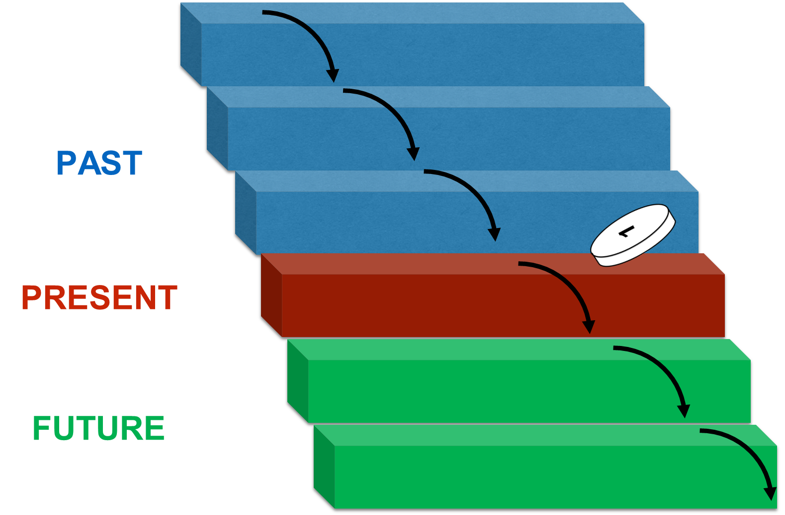

Markov Chains
0.9
0.1
H
T
0.1
0.9
Stationary probability vector (equilibrium):
Homogenous: transition probabilities are constant
Irreducibility (weakly connected with no absorbing states)
Periodicity
Recurrent / transient state (always / never come back). If all states are recurrent the chain is ergodic.
Detailed balance guarantees convergence to a stationarity distribution
$$π=\left[π\left(A\right),π\left(B\right)\right], π(A)=P(X_{ }=A)$$
$$πQ=π$$
A
B
A
B
C
D
A
B
$$π\left(A\right)P\left(A→B\right)=π\left(B\right)P\left(B→A\right)$$

Slide 5
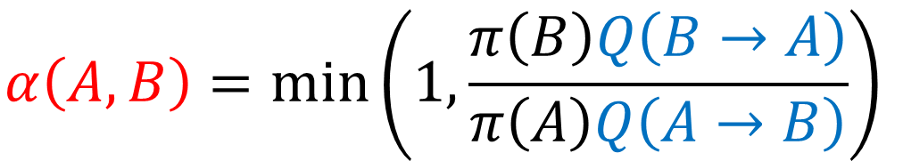
Metropolis – Hastings Algorithm Derivation
Markov Chain Monte Carlo usefulness: construct our own Markov Chain that converges to a specific probability distribution.
detailed balance
$$π\left(A\right)P\left(A→B\right)=π\left(B\right)P\left(B→A\right)$$
proposal distribution
$$π\left(A\right)Q\left(A→B\right)≠π\left(B\right)Q\left(B→A\right)$$
correcting term
$$π\left(A\right)Q\left(A→B\right)α(A,B)=π\left(B\right)Q\left(B→A\right)α(B,A)⇔\frac{α(A,B)}{α(B,A)}=\frac{π\left(B\right)Q\left(B→A\right)}{π\left(A\right)Q\left(A→B\right)}$$
Metropolis-Hastings
$$α\left(A,B\right)=min\left(1,\frac{π\left(B\right)Q\left(B→A\right)}{π\left(A\right)Q\left(A→B\right)}\right)$$
Notes:
Alternative demonstration: https://www.youtube.com/watch?v=5lyw0nnyJt8 .

Slide 6
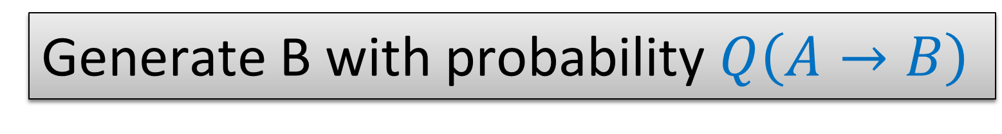
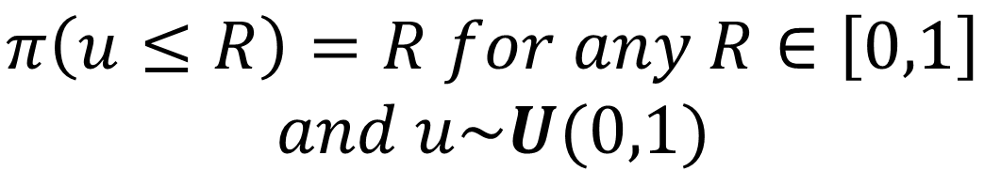
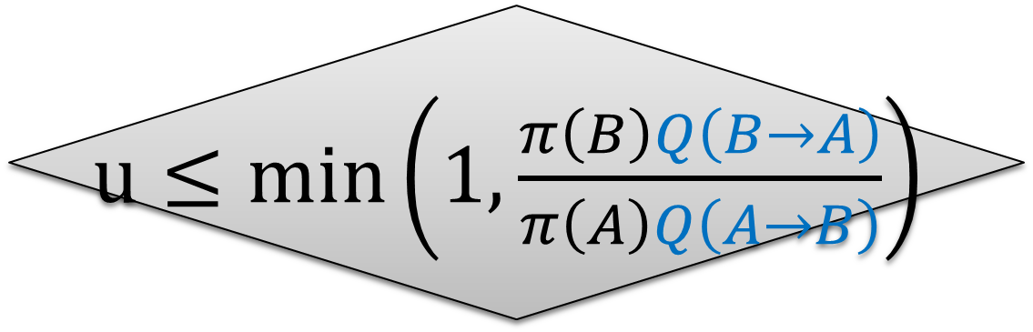
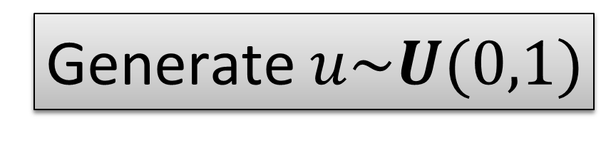
Metropolis – Hastings Algorithm
Draw A from initial π
$$π\left(u≤R\right)=R for any R∈\left[0,1\right]$$
$$and u\sim U(0,1)$$
0
R
1
Generate B with probability $Q\left(A→B\right)$
Generate $u\sim U(0,1)$
$u≤min\left(1,\frac{π\left(B\right)Q\left(B→A\right)}{π\left(A\right)Q\left(A→B\right)}\right)$
Reject (A → A)
NO
YES
Accept (B → A)

Slide 7
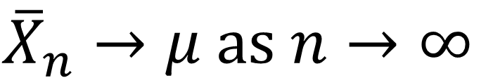
MCMC In Practice: When do we start recording?
The initial distribution is not known. Burn-in
achieve stationarity within a certain threshold
get to a high probability region
$${\overline{X}}_{n}→μ as n→∞$$

Slide 8
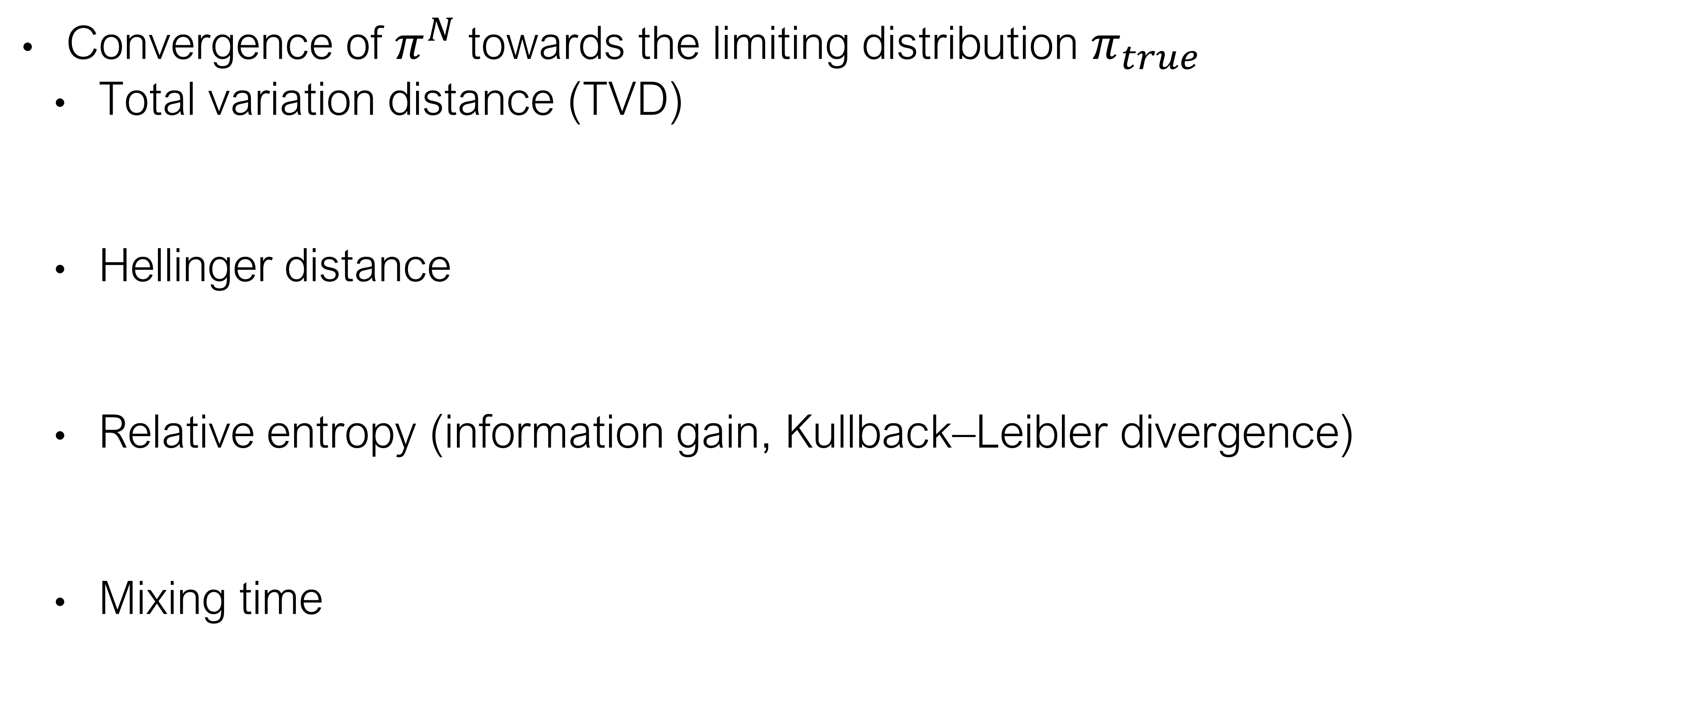
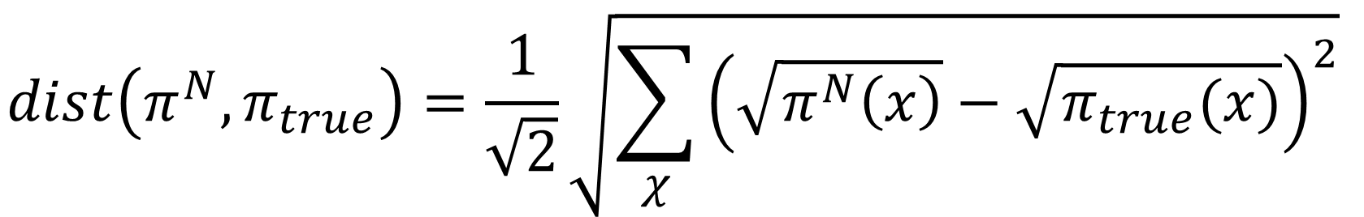
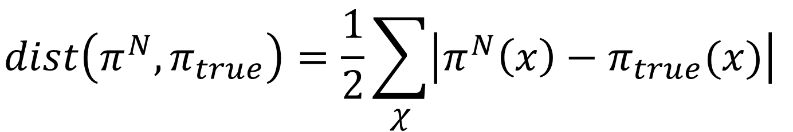
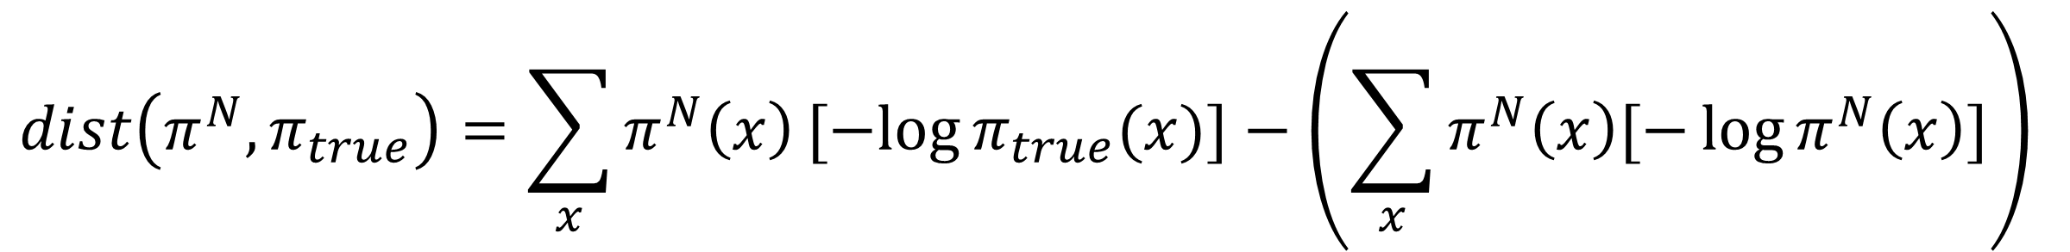
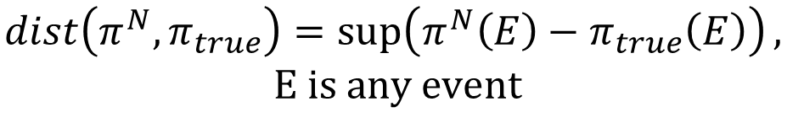
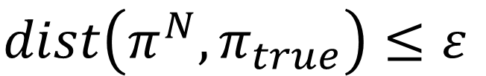
MCMC In Practice: When do we stop recording?
Convergence of $π^{N}$towards the limiting distribution $π_{true}$
Total variation distance (TVD)
Hellinger distance
Relative entropy (information gain, Kullback–Leibler divergence)
Mixing time
$$dist\left(π^{N},π_{true}\right)≤ε$$
$$dist\left(π^{N},π_{true}\right)=\frac{1}{2}\sum_{χ}{\left|π^{N}\left(x\right)−π_{true}(x)\right|}$$
$$dist\left(π^{N},π_{true}\right)=\sup\left(π^{N}\left(E\right)−π_{true}\left(E\right)\right),$$
$$E is any event$$
$$dist\left(π^{N},π_{true}\right)=\frac{1}{\sqrt{2}}\sqrt{\sum_{χ}{{\left(\sqrt{π^{N}\left(x\right)}−\sqrt{π_{true}(x)}\right)}^{2}}}$$
$$dist\left(π^{N},π_{true}\right)=\sum_{x}{π^{N}\left(x\right)[−log{π_{true}(x)}]}−\left(\sum_{x}{π^{N}\left(x\right)[−\log{π^{N}\left(x\right)}]}\right)$$
$$t_{mix}\left(ε\right)=min⁡\{t:dist(t)≤ε\}$$
Levin Peres and Wilmer, “Markov Chains and Mixing Times”
Notes:
KL distance is not a true metric. Triangle inequality doesn’t hold.

Slide 9
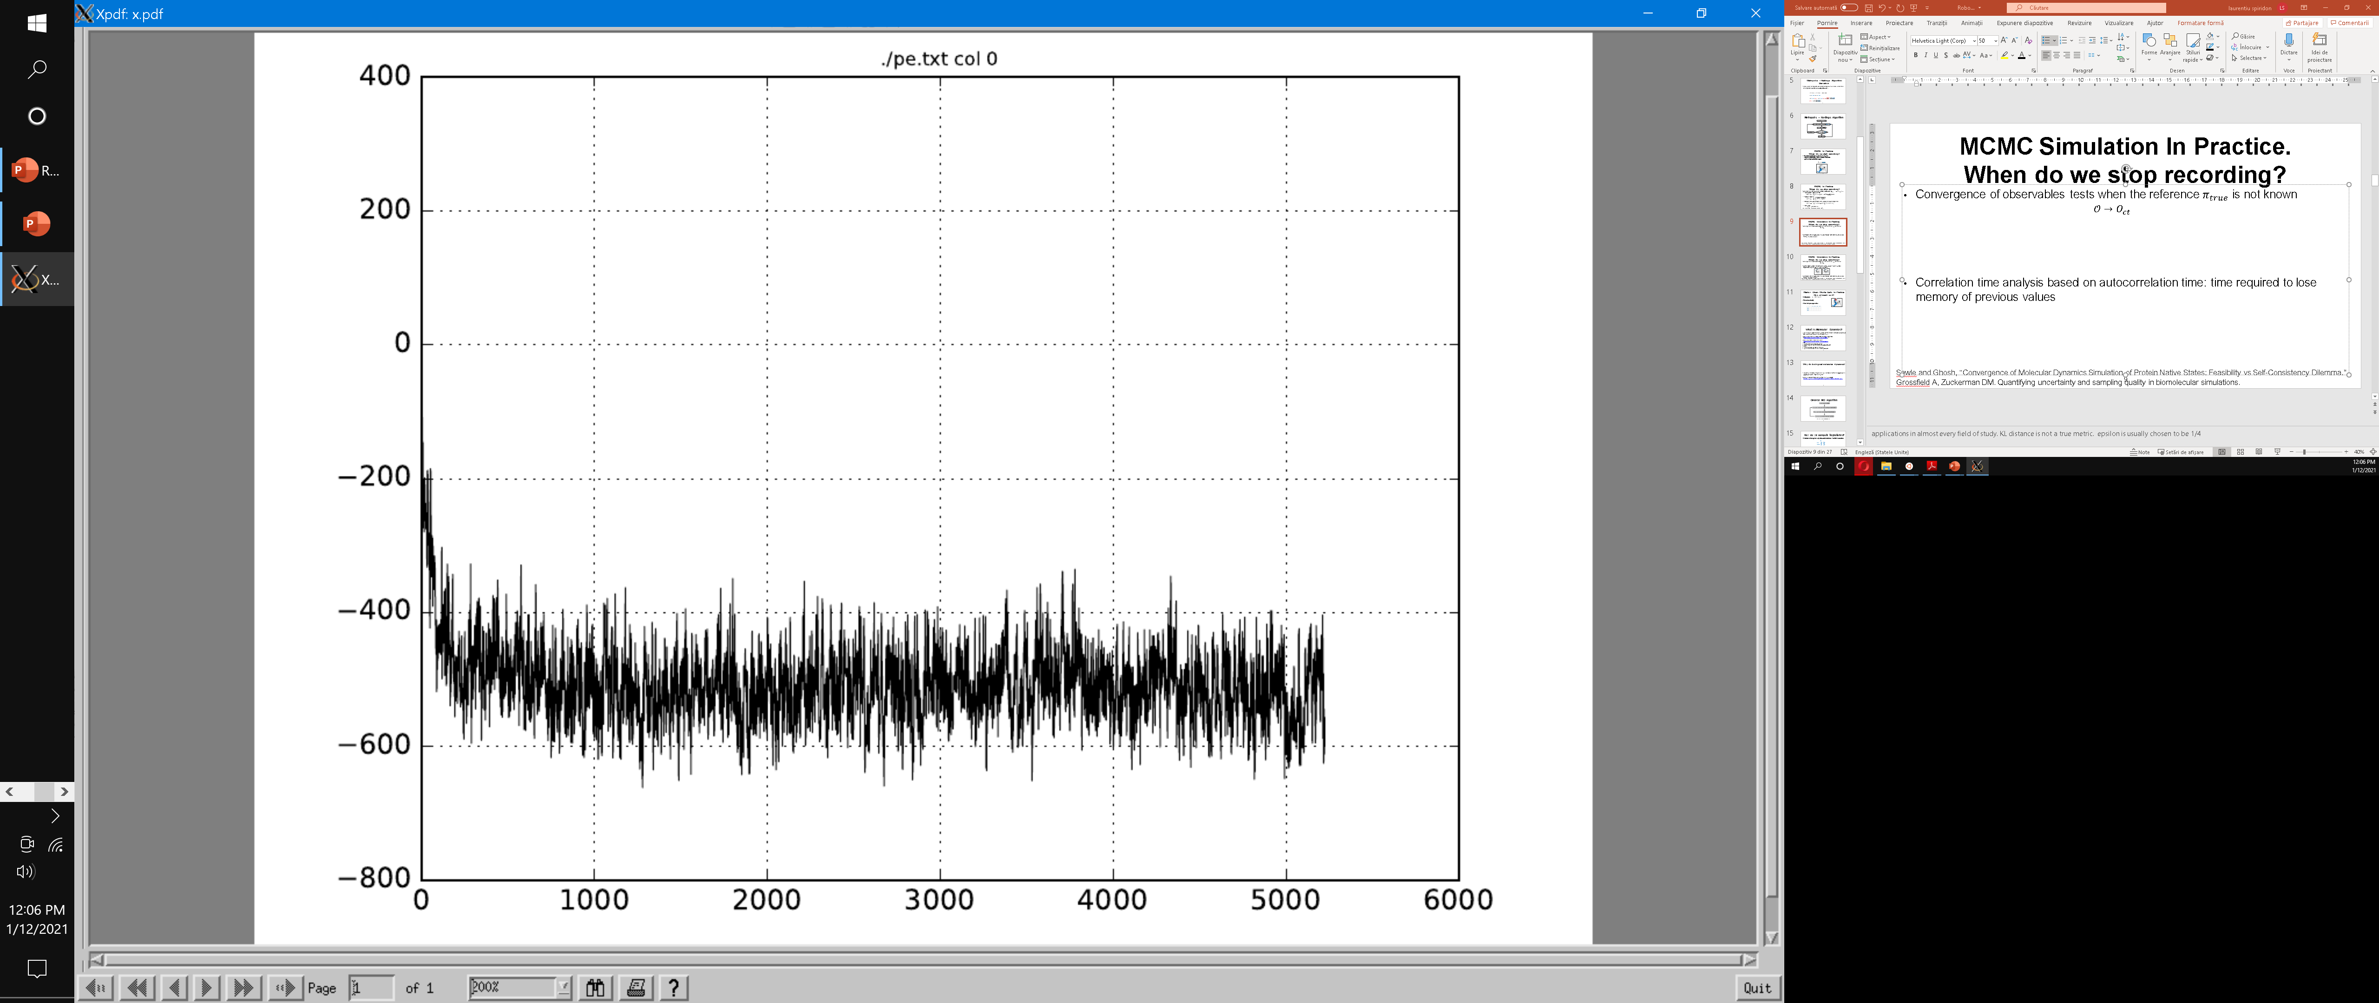
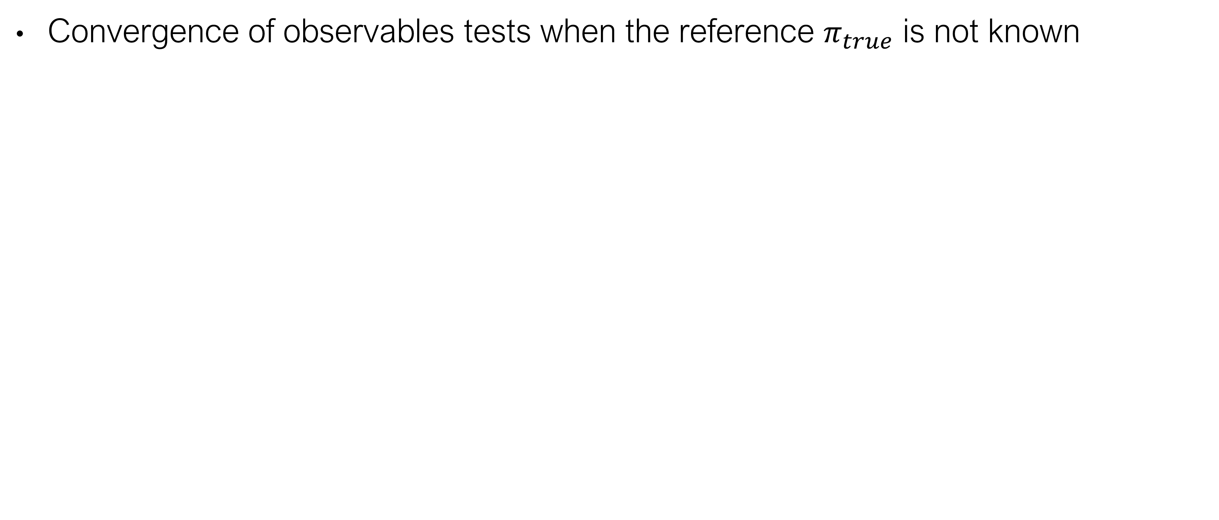
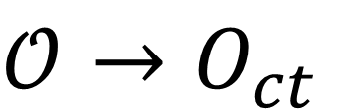
MCMC Simulation In Practice. When do we stop recording?
Convergence of observables tests when the reference $π_{true}$ is not known
$$𝒪→O_{ct}$$
PE
step
Sawle and Ghosh, “Convergence of Molecular Dynamics Simulation of Protein Native States: Feasibility vs Self-Consistency Dilemma.”
Grossfield A, Zuckerman DM. Quantifying uncertainty and sampling quality in biomolecular simulations.

Slide 10
MCMC Simulation In Practice. When do we stop recording?
Self-consistency tests: “monitoring the overlap between full and partial trajectories”. E.g. constant number of clusters.
2
1
2
1
3
3
5
4
4
Sawle and Ghosh, “Convergence of Molecular Dynamics Simulation of Protein Native States: Feasibility vs Self-Consistency Dilemma.”
Grossfield A, Zuckerman DM. Quantifying uncertainty and sampling quality in biomolecular simulations.

Slide 11
MCMC In Practice: How efficient is it?
Correlation time analysis: time required to lose memory of previous values
Hitting time
Cover time
Mean first passage matrix
1
2
5
3
4
 | 1 | 2 | 3 | 4 | 5
1
2
3
4
5

Slide 12
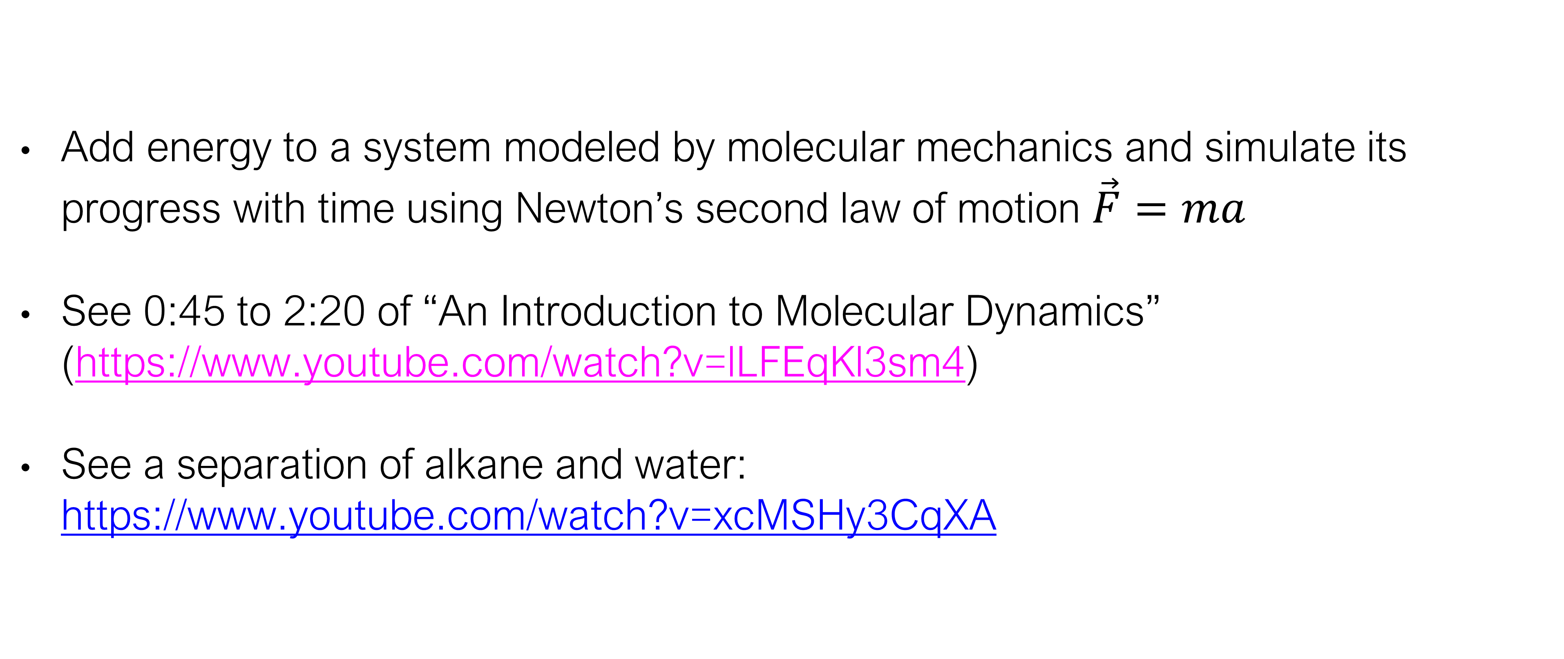
What is Molecular Dynamics?
Add energy to a system modeled by molecular mechanics and simulate its progress with time using Newton’s second law of motion $\vec{F}=ma$
See 0:45 to 2:20 of “An Introduction to Molecular Dynamics” (https://www.youtube.com/watch?v=lLFEqKl3sm4)
See a separation of alkane and water: https://www.youtube.com/watch?v=xcMSHy3CqXA

Slide 13
Why do biological molecular dynamics?
“everything that living things do can be understood in terms of the jigglings and wigglings of atoms” - Richard Feynman
Check out David’s molecular dynamics YouTube playlist: https://www.youtube.com/playlist?list=PLYEyeVFrqfAu0ft6sF4vVe5FOEbJYyi_L

Slide 14
General MD Algorithm
Figure 2 of Durrant & McCammon, 2011

Slide 15
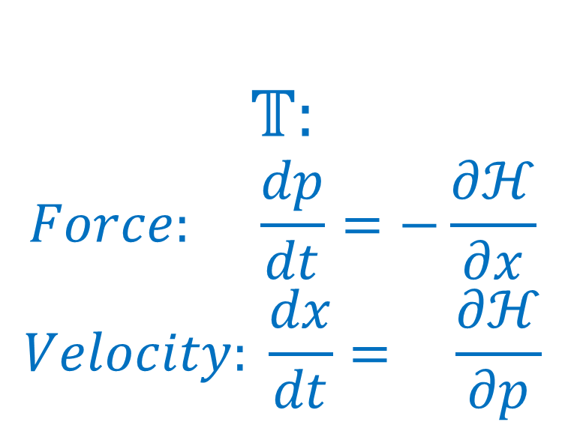
How do we calculate trajectories?
Evolution in time given is by classical mechanics: Hamilton’s equations
Integrate trajectory using Taylor expansion
$$𝕋:$$
$$Force: \frac{dp}{dt}=−\frac{∂ℋ}{∂x}$$
$$Velocity: \frac{dx}{dt}= \frac{∂ℋ}{∂p}$$
$$x\left(t\right)=\frac{1}{0!}x\left(t_{0}\right){\left(t−t_{0}\right)}^{0}+\frac{1}{1!}\frac{dx}{dt}\left(t_{0}\right){\left(t−t_{0}\right)}^{1}+\frac{1}{2!}\frac{d^{2}x}{{dt}^{2}}\left(t_{0}\right){\left(t−t_{0}\right)}^{2}+\frac{1}{3!}\frac{d^{3}x}{{dt}^{3}}\left(t_{0}\right){\left(t−t_{0}\right)}^{3}+…$$

Slide 16

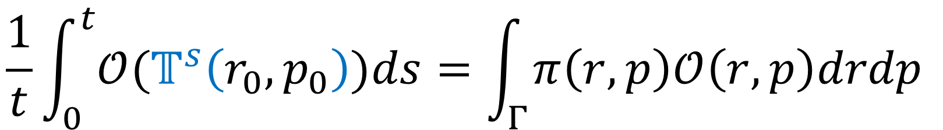
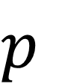
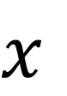
Ergodic Hypothesis
Evolution in time given by classical mechanics: Hamilton’s equations
Time averages equals space averages
$$𝕋:$$
$$Force: \frac{dp}{dt}=−\frac{∂ℋ}{∂r}$$
$$Velocity: \frac{dr}{dt}= \frac{∂ℋ}{∂p}$$
$$p$$
$$\frac{1}{t}\int_{0}^{t}{{𝒪(𝕋}^{s}\left(r_{0},p_{0}\right))ds}=\int_{Γ}^{ }{π\left(r,p\right)𝒪\left(r,p\right)drdp}$$
$$x$$

Slide 17
Disscussion
MD:
- correct model of molecular behavior
- approximates the desired probability distribution in the end
MCMC:
- doesn’t provide behavior of molecules
- guarantees samples from the desired distribution

Slide 18
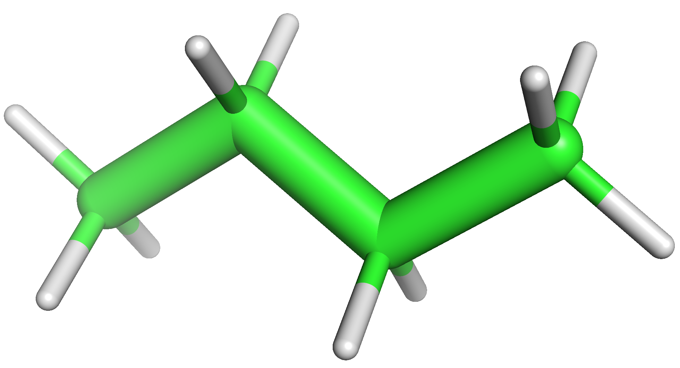
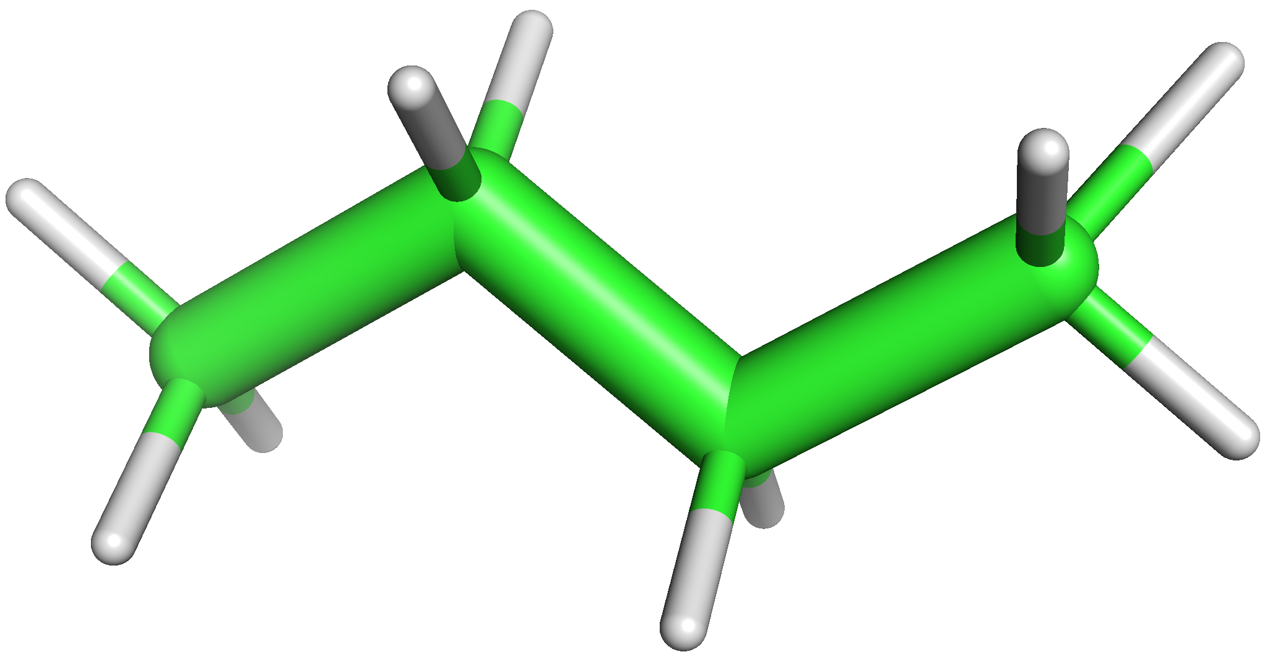
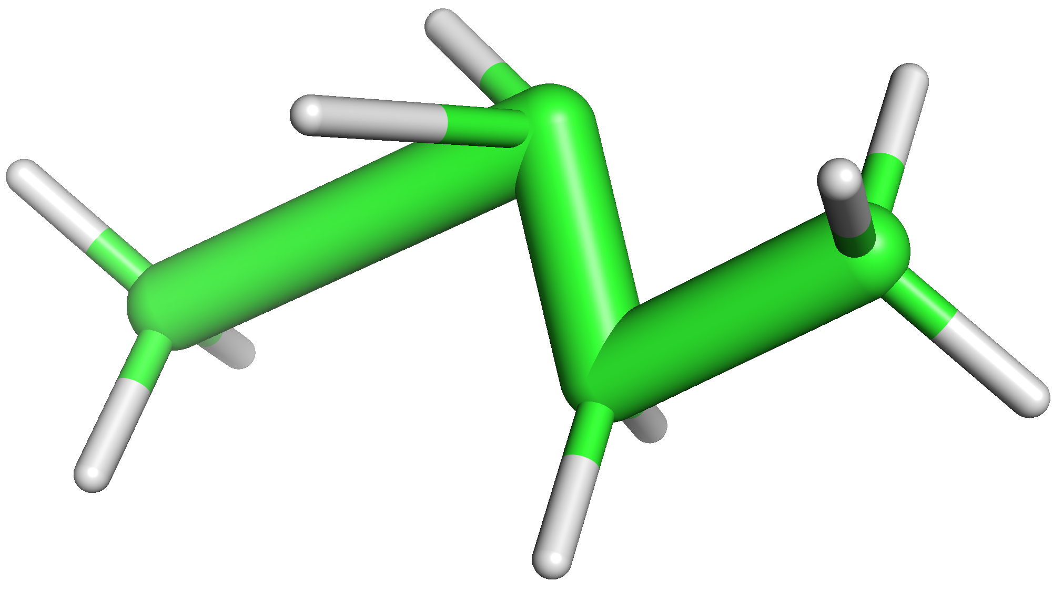
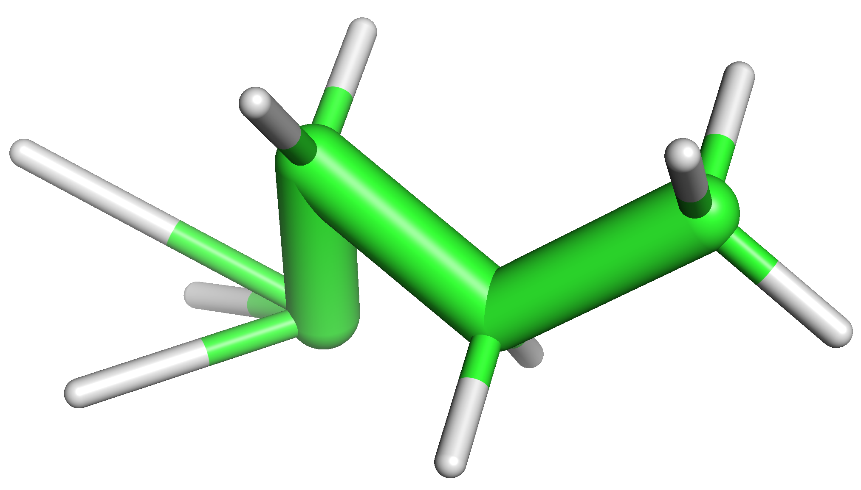
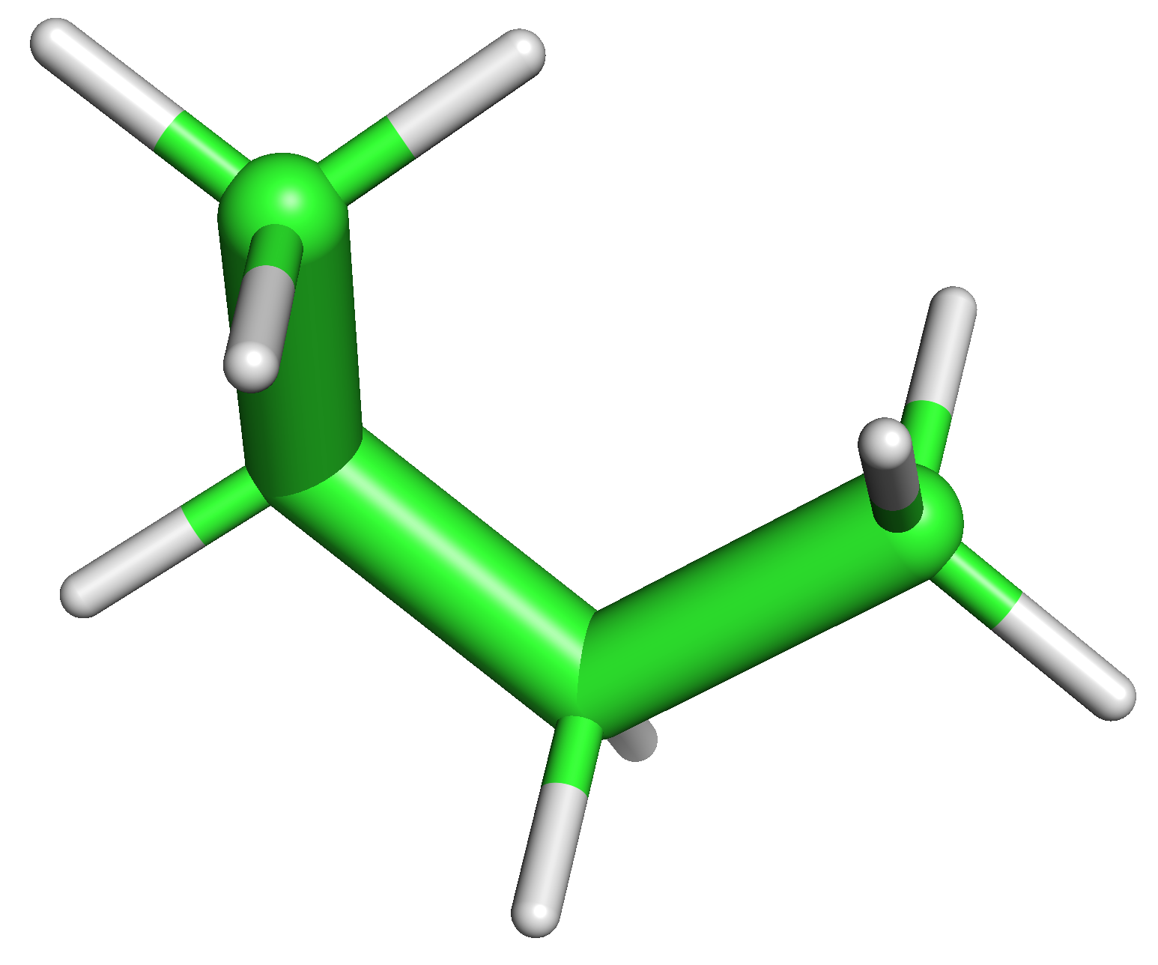
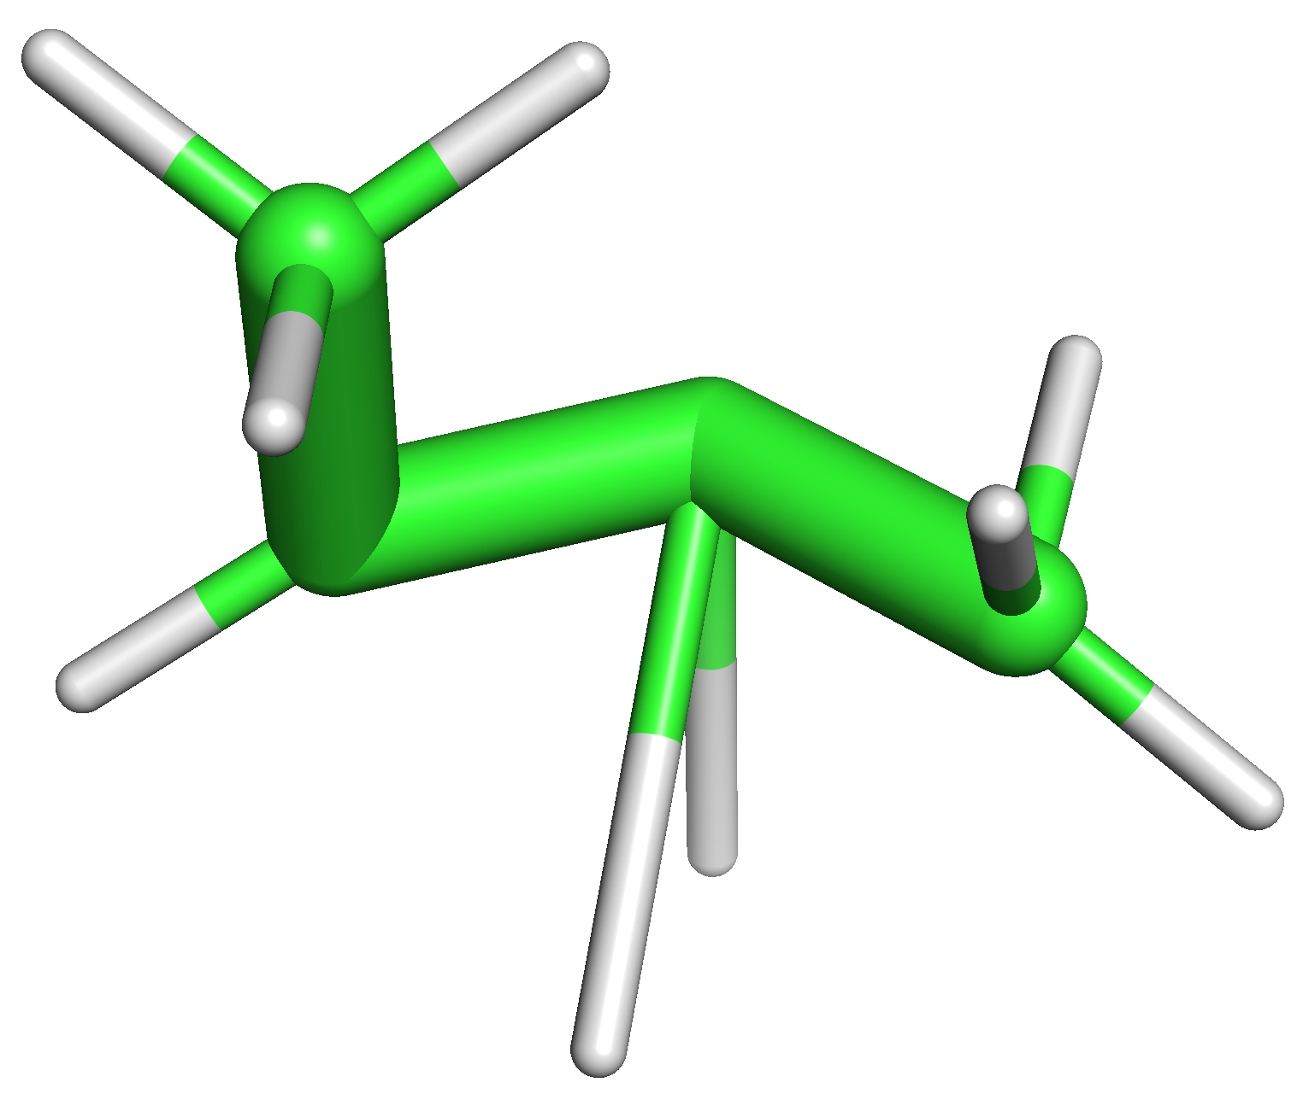
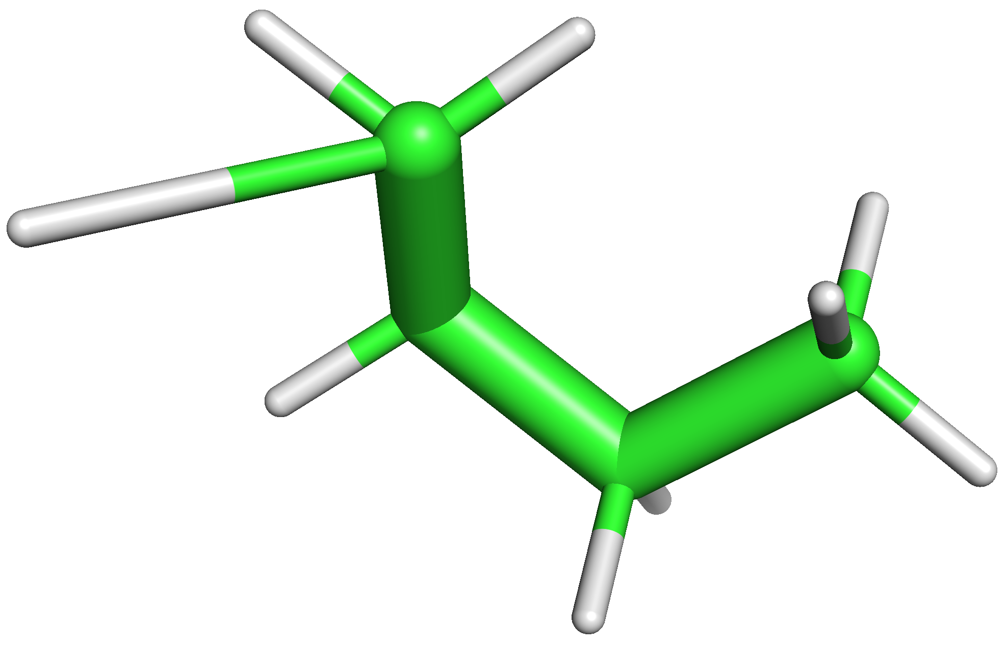
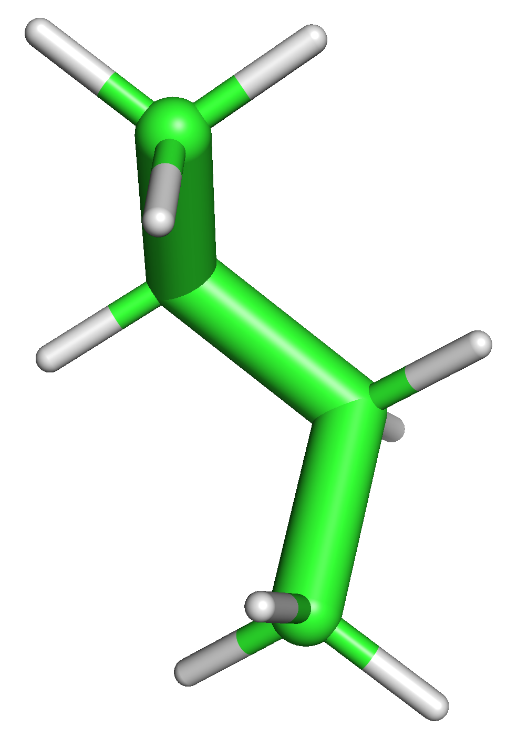
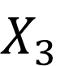
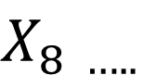
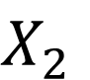
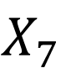
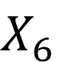
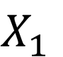
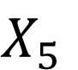
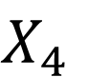
Markov Chain Monte Carlo for biological molecules
Randomly chosen configurations lead to low acceptance rates
Can we do better?
$$X_{1}$$
$$X_{2}$$
$$X_{3}$$
$$X_{4}$$
$$X_{5}$$
$$X_{6}$$
$$X_{7}$$
$$X_{8 …..}$$
18

Slide 19
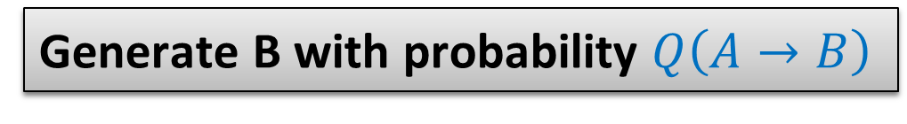
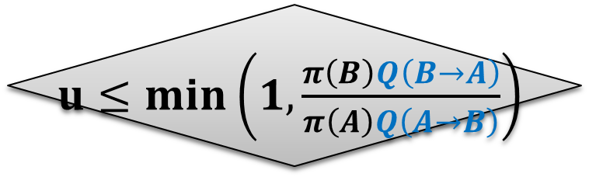
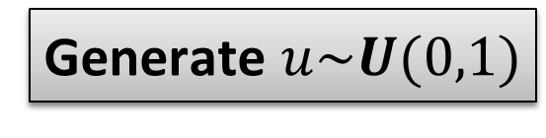
Hybrid Monte Carlo
Draw A from initial π
Generate B with probability $Q\left(A→B\right)$
Molecular Dynamics
Metropolis-Hastings
Algorithm
Generate $u\sim U(0,1)$
NO
$u≤min\left(1,\frac{π\left(B\right)Q\left(B→A\right)}{π\left(A\right)Q\left(A→B\right)}\right)$
YES
Reject (A → A)
Accept (B → A)
19

Slide 20
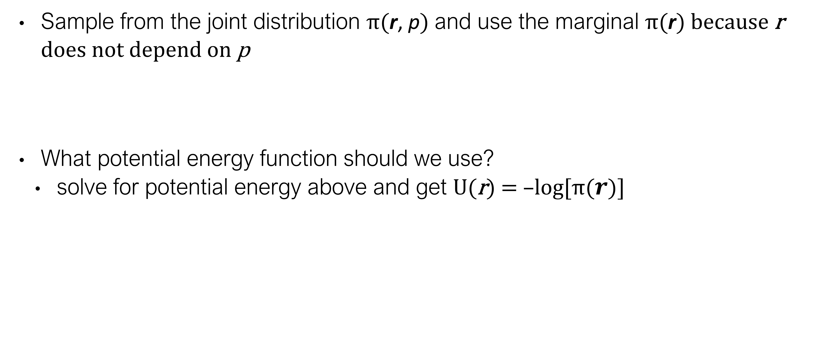
Why does it work?
Sample from the joint distribution π(r, p) and use the marginal π(r) because r does not depend on p
What potential energy function should we use?
solve for potential energy above and get U(r) = –log[π($r$)]
$$π\left(r,p\right)∝e^{−βU\left(r\right)}e^{−β{\frac{1}{2}p}^{T}M^{−1}p}=e^{−βU\left(r\right)}𝒩(0,M)$$

Slide 21
Why use constraints?
Target distribution is highly dimensional and too complex to get conclusive results in reasonable amount of time
Heavier bodies allows the increase of the timestep
E.g. :
rigid water molecules (TIP3P model)
constant bond lengths and bond angles: torsional dynamics
constrain specific regions of molecules or even entire domains
Taken from Figure 3 of Durrant & McCammon, 2011.

Slide 22
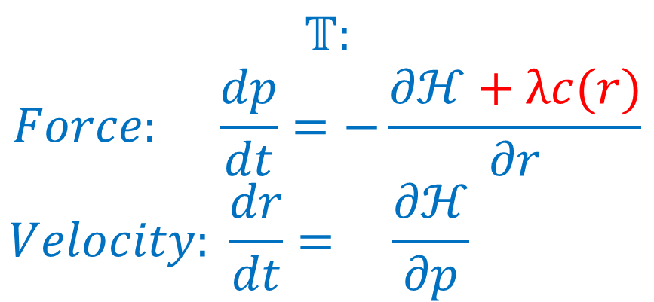
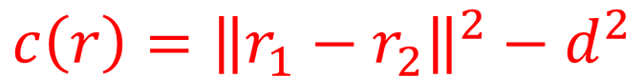
How to impose constraints?
Cartesian coordinates and internal coordinates
Dynamics with maximal coordinates (Lagrange multipliers)
Example SHAKE algorithm usually used for hydrogen atoms bonds
r₁
d
r₂
$$𝕋:$$
$$Force: \frac{dp}{dt}=−\frac{∂ℋ+λc(r)}{∂r}$$
$$Velocity: \frac{dr}{dt}= \frac{∂ℋ}{∂p}$$
$$c\left(r\right)={\left\|r_{1}−r_{2}\right\|}^{2}−d^{2}$$
$$r\left(t\right)=\frac{1}{0!}r\left(t_{0}\right){\left(t−t_{0}\right)}^{0}+\frac{1}{1!}\frac{dr}{dt}\left(t_{0}\right){\left(t−t_{0}\right)}^{1}+\frac{1}{2!}\frac{d^{2}r}{{dt}^{2}}\left(t_{0}\right){\left(t−t_{0}\right)}^{2}+…$$
Taken from Figure 3 of Durrant & McCammon, 2011.
Notes:
The quantization of molecular energy levels encompasses several mechanisms. in practice the different mechanisms differences in magnitude allow their characterization to be examined independently

Slide 23
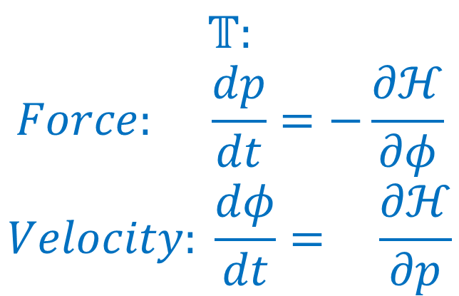
How to impose constraints?
Dynamics reduced coordinates (Featherstone)
Rigid body dynamics includes rotational quantities which are incorporated using Euler’s laws of motion
Dynamics is altered
$$𝕋:$$
$$Force: \frac{dp}{dt}=−\frac{∂ℋ}{∂φ}$$
$$Velocity: \frac{dφ}{dt}= \frac{∂ℋ}{∂p}$$
$$φ\left(t\right)=\frac{1}{0!}φ\left(t_{0}\right){\left(t−t_{0}\right)}^{0}+\frac{1}{1!}\frac{dφ}{dt}\left(t_{0}\right){\left(t−t_{0}\right)}^{1}+\frac{1}{2!}\frac{d^{2}φ}{{dt}^{2}}\left(t_{0}\right){\left(t−t_{0}\right)}^{2}+…$$
Taken from Figure 3 of Durrant & McCammon, 2011.
Notes:
Internal coordinates forms a curvilinear system that has to be corrected for. Hamiltonain has to be modified to match the target pi.

Slide 24
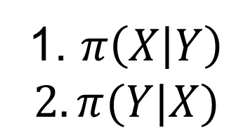
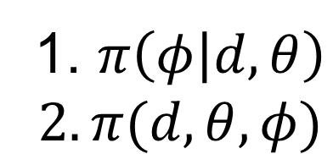
Gibbs sampling
Why?
Only simulating with constraints is not enough. The simulation does not cover the entire conformational space
Sampling from complex multivariate joint probability.
How?
Take turns in sampling from conditionals. Allow oversampling easier to sample variables.
Robosample scheme: constrained dynamics combined with all-atom dynamics
1. $π\left(X | Y\right)$
$$2. π(Y|X)$$
1. $π\left(φ | d,θ\right)$
$$2. π(d,θ,φ)$$
Notes:
Robosample uses Blocked Gibbs with Marginalization.

Slide 25
Why Robosample?
Many choices of software for molecular dynamics
https://en.wikipedia.org/wiki/Comparison_of_software_for_molecular_mechanics_modeling
https://www.rcsb.org/pages/thirdparty/modeling_and_simulation
Robosample is
rigid body dynamics
free
GPU-accelerated
can be used in python scripts/C++ programs

Slide 26
Review Questions
Generally speaking, how does a HMC simulation work?

Slide 27
References
Durrant, J. D.; McCammon, J. A. Molecular Dynamics Simulations and Drug Discovery. BMC Biol 2011, 9 (1), 71. https://doi.org/10.1186/1741-7007-9-71, adapted under the CC BY 2.0 license.
Kalos, Malvin H.; Whitlock, Paula A. (2008). Monte Carlo Methods.
Levin DA, Peres Y and Wilmer EL, “Markov Chains and Mixing Times”, American Mathematical Soc., Oct 31, 2017, ISBN: 1470429624, 9781470429621
Sawle L, Ghosh K. Convergence of Molecular Dynamics Simulation of Protein Native States: Feasibility vs Self-Consistency Dilemma. J Chem Theory Comput. 2016 Feb 9;12(2):861-9. doi: 10.1021/acs.jctc.5b00999. Epub 2016 Jan 26. PMID: 26765584.
Grossfield A, Zuckerman DM. Quantifying uncertainty and sampling quality in biomolecular simulations. Annu Rep Comput Chem. 2009 Jan 1;5:23-48. doi: 10.1016/S1574-1400(09)00502-7. PMID: 20454547; PMCID: PMC2865156.

